Slide 1
Electric Power Testing – Advanced Analysis
Get insights into your drive
Mitch Marks / Klaus Lang
Business Development Management – Electric Power Testing

Slide 2
Examples
Vibration measurement
CAN bus correlation
dq0 & Space Vectors
Drive cycle power
Dynamic power
Dynamic torque
Torque ripple
In car drive cycle
Inverter Control Calibration

Slide 3
Vibration Measurements in Electric Machines

Slide 4
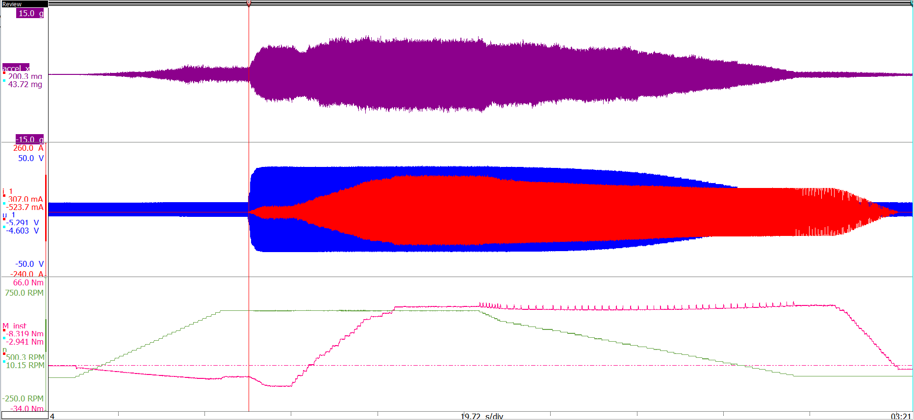
Correlate Vibration, Torque, and Electric Power
HOME
Voltage and current cause torque and vibration
Combined measurements help to correlate vibration, electrical, and rotational effects
In this example:
Vibration increases with torque
Vibration decreases with speed
Measurement of the electro- mechanical system
– Acceleration – Current – Voltage
– Torque – Speed
Vibration measured with voltage, current, torque, and speed. The machine is ramped in torque and speed to look at the vibration for each point.

Slide 5
Synchronized CAN bus measurements

Slide 6
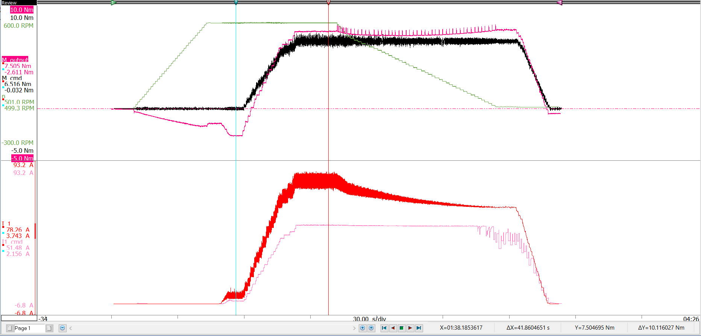
CAN bus measurement – Comparison of control and reality
HOME
Acquisition and display of CAN control signals and their measured counterparts
Evaluate internal controller and sensors
Tune the system and make engineering decisions
Understand failures
Speed up development time and measure the whole system
– Torque
– Torque CMD
– Speed
– Current
– Current CMD
CAN commands for torque and phase 1 current compared to their measured values. This test was performed on a malfunctioning machine

Slide 7
dq0 & Space Vector Transformations

Slide 8
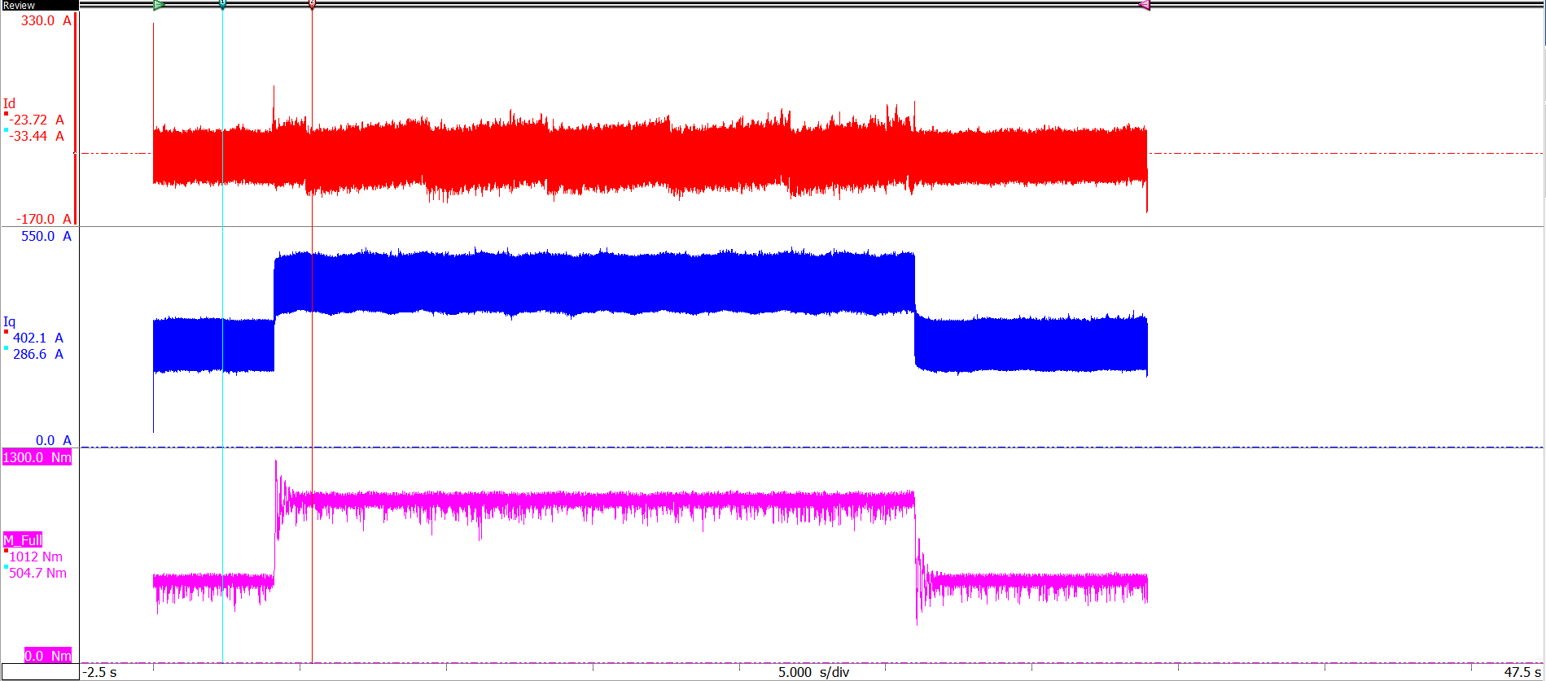
dq0 transformation in a live display
HOME
Real time dq0-transformation for a load step in an induction machine
Time domain display of d-,q-signals
Insight on what´s happening in the machine
Time synchronized to other signals
– I_d
– I_q
–Torque
Load step in an induction machine. I_q and torque are directly related to one another

Slide 9
Drive Cycle Power Measurements

Slide 10
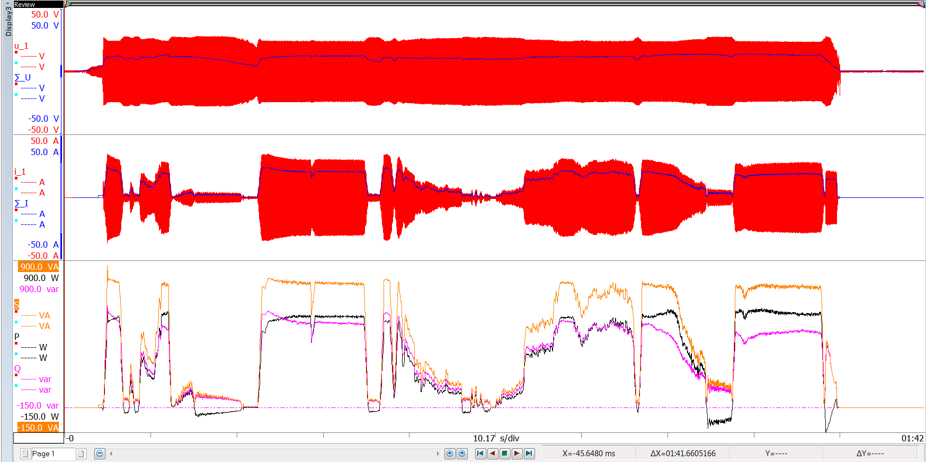
User Driving Patterns Effect Efficiency
HOME
Increased losses in dynamic situations make drive cycle testing necessary
Testing the system the way a user will gives accurate range estimations
Cycle based power analyzer can accurately measure dynamic power
Dynamic power is needed to optimize the machine controller
Only possible with cycle based measurement
– Instantaneous Signals
– RMS Signals
– Power
– Reactive Power
– Apparent Power
Dynamic signals from laps around a track on an electric scooter. Including: starts, stops, coasts, uphill and downhill

Slide 11
Dynamic Power Measurements

Slide 12
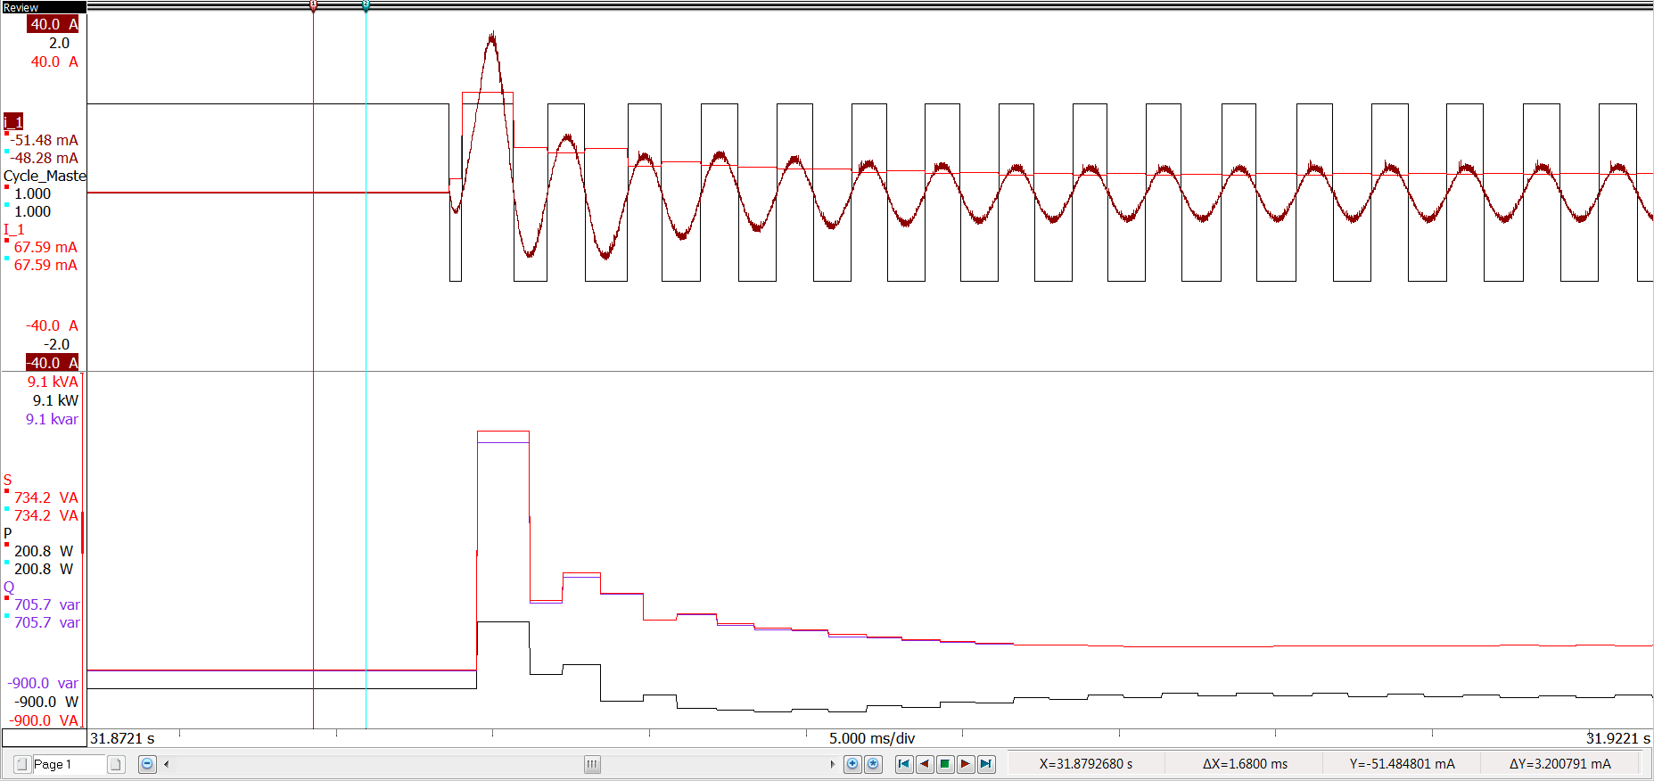
Importance of Dynamic Power Measurement
At motor start, stop, or change of state there are losses associated with state change
Example of an inverter started induction machine
Large reactive power during the transient resulting in inefficiency
Dynamic power measurements needed to understand actual efficiency during use
Only possible with cycle detect
Current Inrush
– Current
– RMS Current
– Cycle detect
Reactive Power Spike
– Power
– Reactive Power
– Apparent Power
Current suddenly applied to an electric motor and associated power, reactive power, and apparent power for this dynamic load change

Slide 13
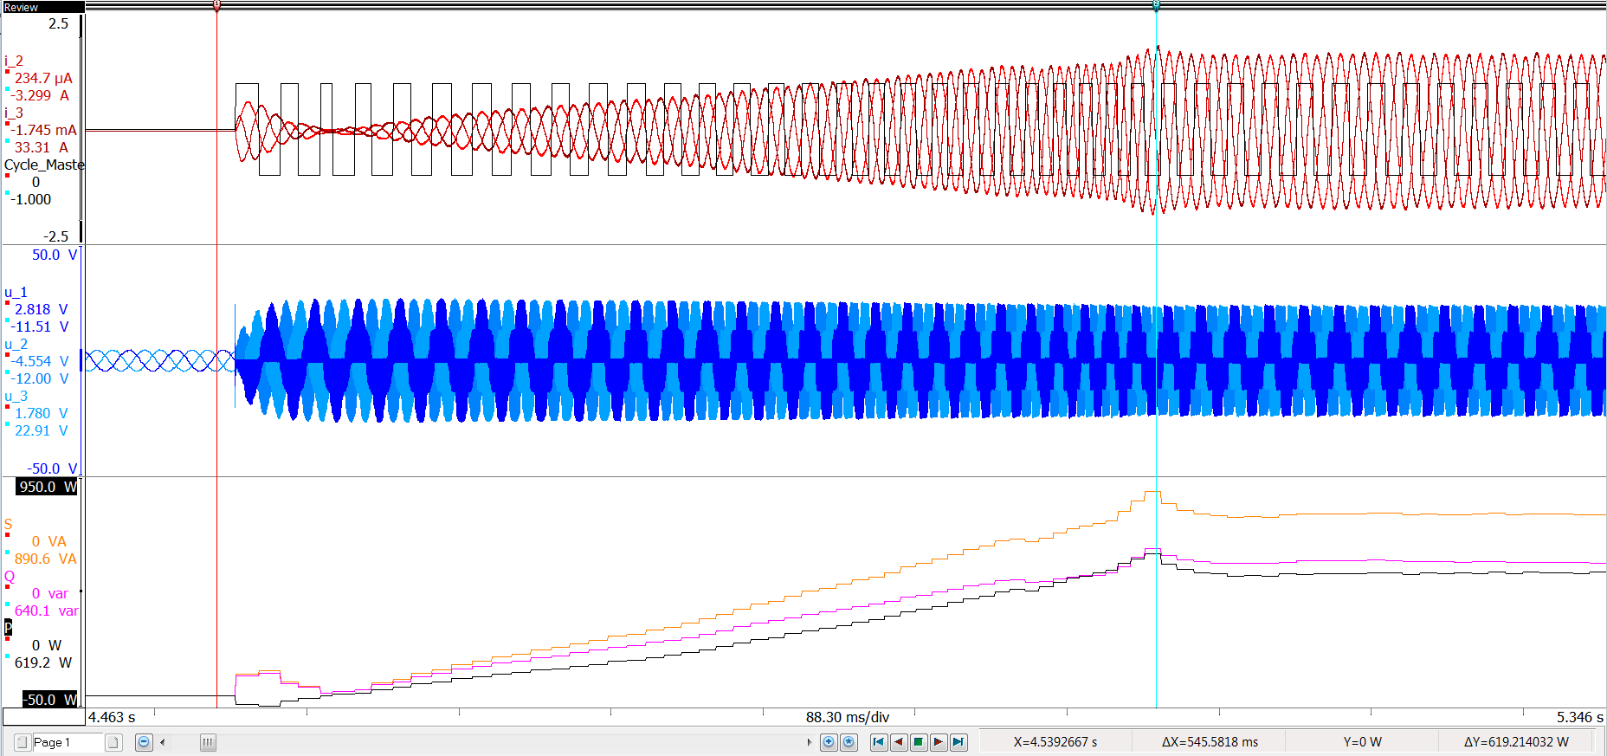
Dynamic Power Starting
HOME
Inrush of current when vehicle starts
Voltage and current frequencies increase
Extra power and reactive power needed to start the vehicle
Overshoot of current, power, and reactive power at cursor
Inrush Current
– Currents
– Cycle detect
– Voltages
Power Overshoot
– Power
– Reactive Power
– Apparent Power
Scooter acceleration from 0 speed showing a ramp from 0 to full power.
Note back EMF and PWM operation.

Slide 14
Dynamic Torque Measurement

Slide 15
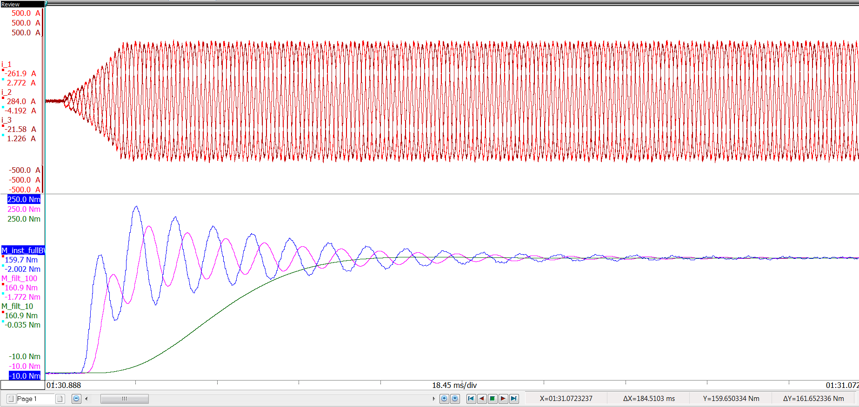
Properly Measuring Dynamic Torque
HOME
Torque from load steps has dynamic content
Torque responses often have overshoots and settling time
Overshoots can harm the system
Filtered torque has phase delay and loses some amplitude info
Highly filtered torque has large phase delay and loses all amplitude and frequency info
Current –
– Currents
– Full Bandwidth Torque
– 100 Hz Filtered Torque
– 10 Hz Filtered Torque
Phase Delay
Load step for an electric machine and cyclical torque with different filter rates

Slide 16
Torque Ripple

Slide 17
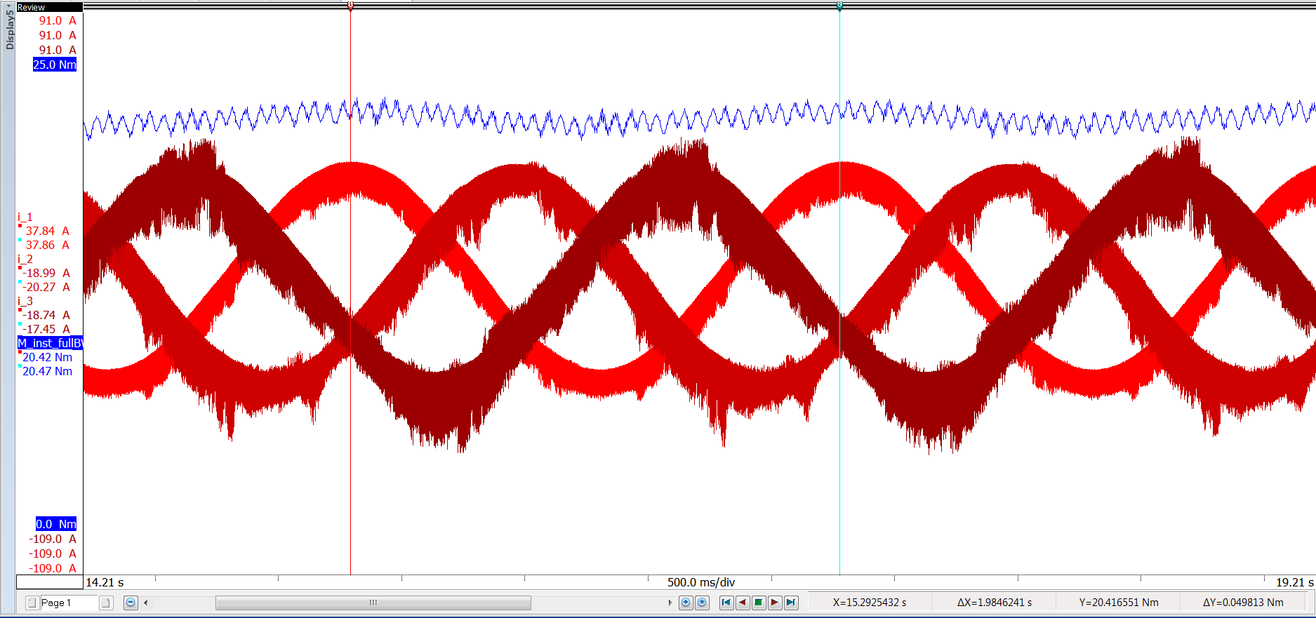
Torque ripple → Dynamic torque in a steady state
Torque is not constant
It always is a DC with an AC ripple
Ripple has a cyclical nature
The ripple is a function of motor construction and excitation
Slots
Magnets
Ripple frequency is proportional to speed
Full measurement chain with understanding of all elements
36 ripples / electrical cycle
– Torque
– Currents
Three phase motor excitation currents (red) and resultant torque ripple (blue)

Slide 18
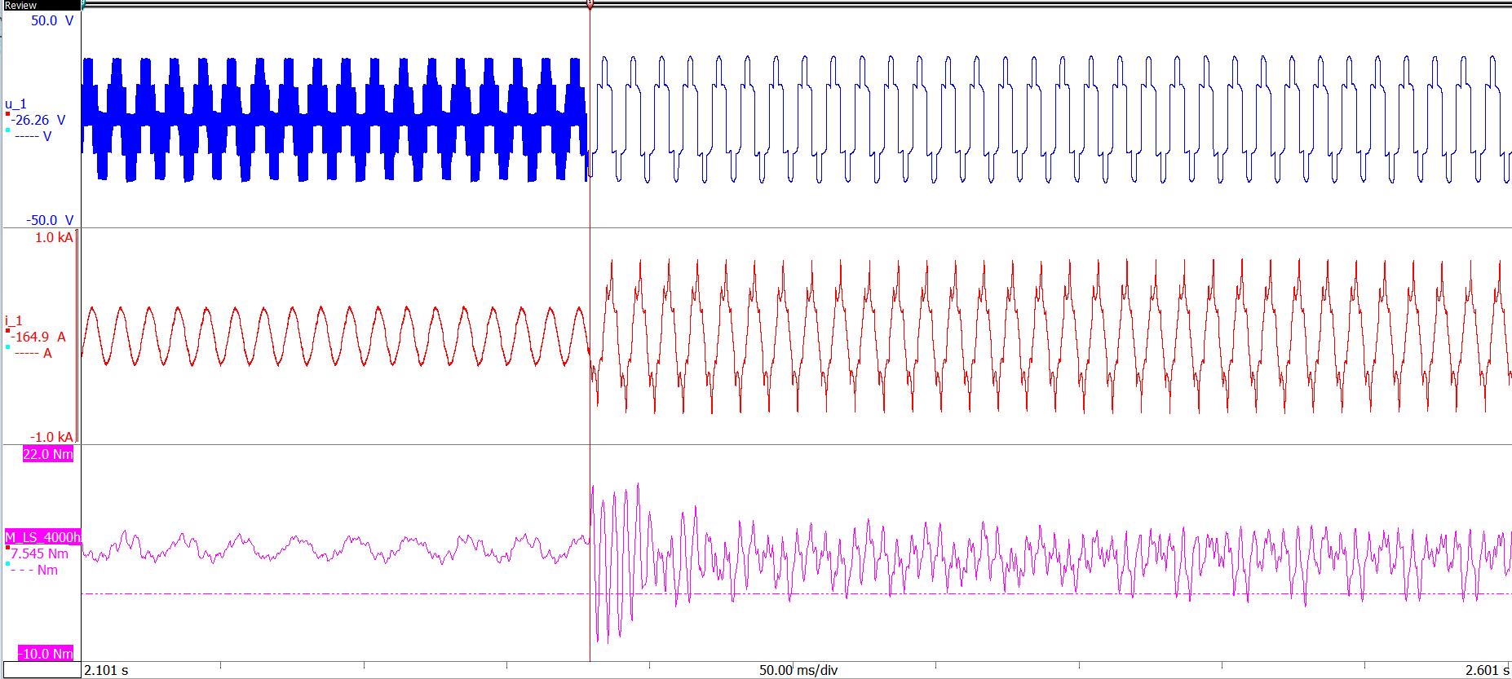
Torque ripple → Effects of the Inverter
HOME
Control changes are a good opportunity to look at torque transients
Example: Control change from PWM to six step (smooth sine wave to jagged)
Ripple frequency increases with control change
Negative torque swings
Full measurement chain with understanding of all elements:
Effect can be tied back to Vibration
– Voltage
– Current
– Torque
Control change from PWM to 6 step

Slide 19
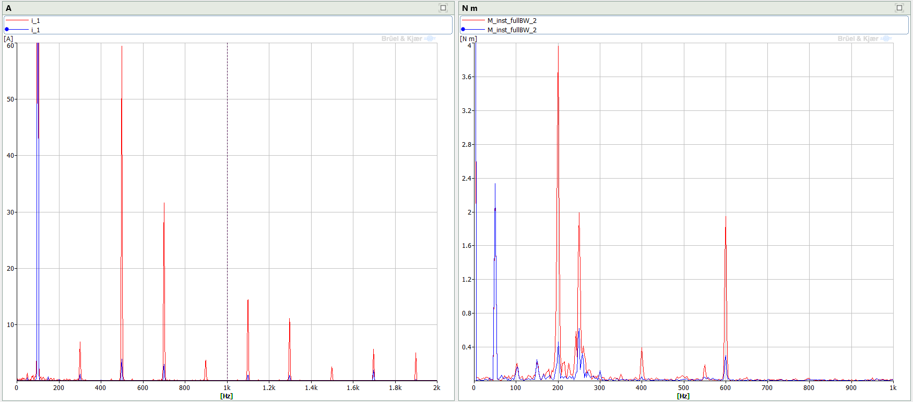
Voltage, Current, and Torque Frequency Content
Fundamental and rotational current and torque are similar
6 step current has significantly more current harmonic content in PWM
5th , 7th, 11th, …
Torque has significantly more harmonic content during PWM
4x, 5x, 8x, 10x, 12x rotational frequency
Linked to current
Real time or post process FFT for system level understanding
PWM
6 step
PWM
6 step
Poles
Frequency spectrum comparing current and torque during PWM and 6 step operation
5th electrical harmonic
Construction
Switching

Slide 20
In Vehicle Electric Power Measurement

Slide 21
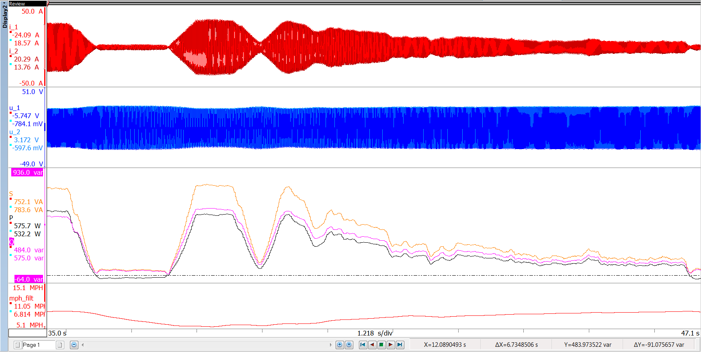
Real World Road Dynamics
HOME
Driving in different scenarios results in different current profiles
Power changing with environment or driver habits
Power fluctuations influence system efficiency
Understand control behavior to disturbances
Coast
Full Throttle
Downhill Acceleration
– Current
– Voltage
– Power
– Reactive Power
– Apparent Power
Scooter dynamics for full throttle, a coast, and downhill acceleration

Slide 22
Inverter Control Calibration

Slide 23
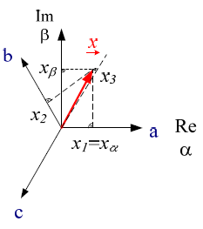
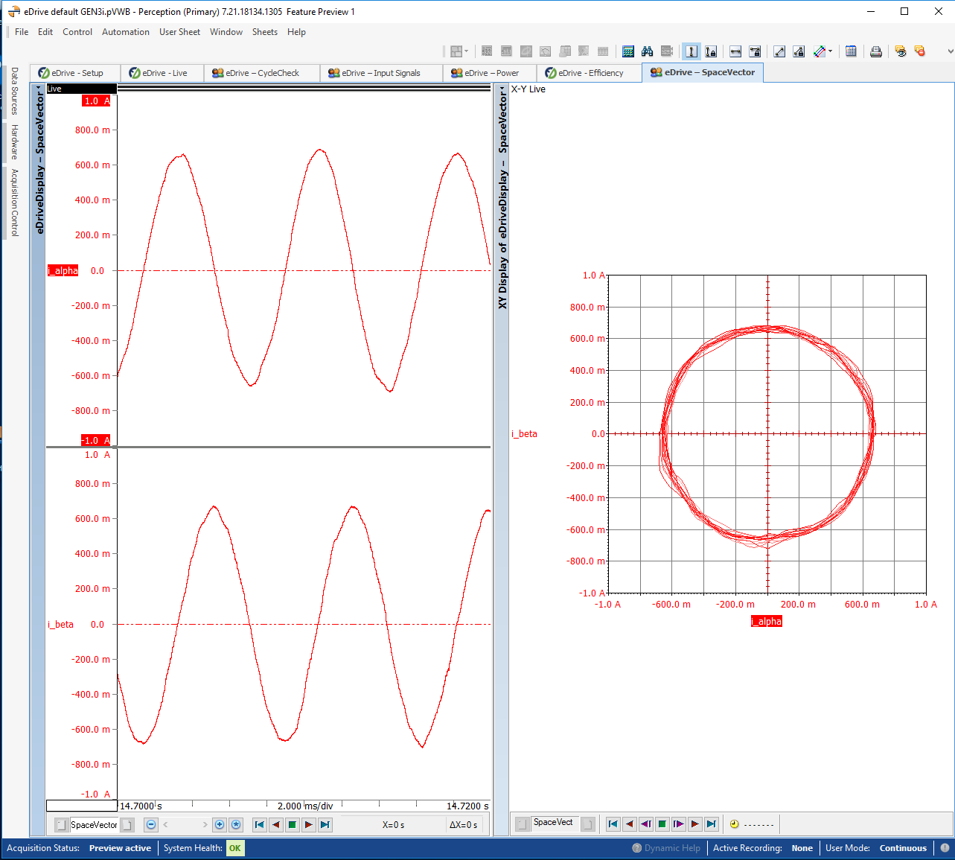
Space vectors to analyze control
The three currents i₁, i₂, i₃ of a 3-phase system are represented with two linear independent vectors i_{α} , i_{β}.
Doing so motor models are simplified
Control algorithms can be drafted more easily

Slide 24
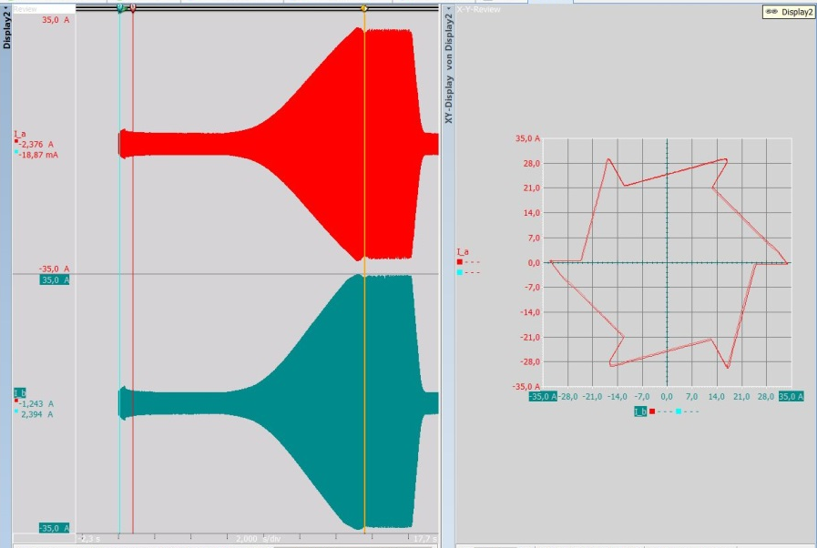
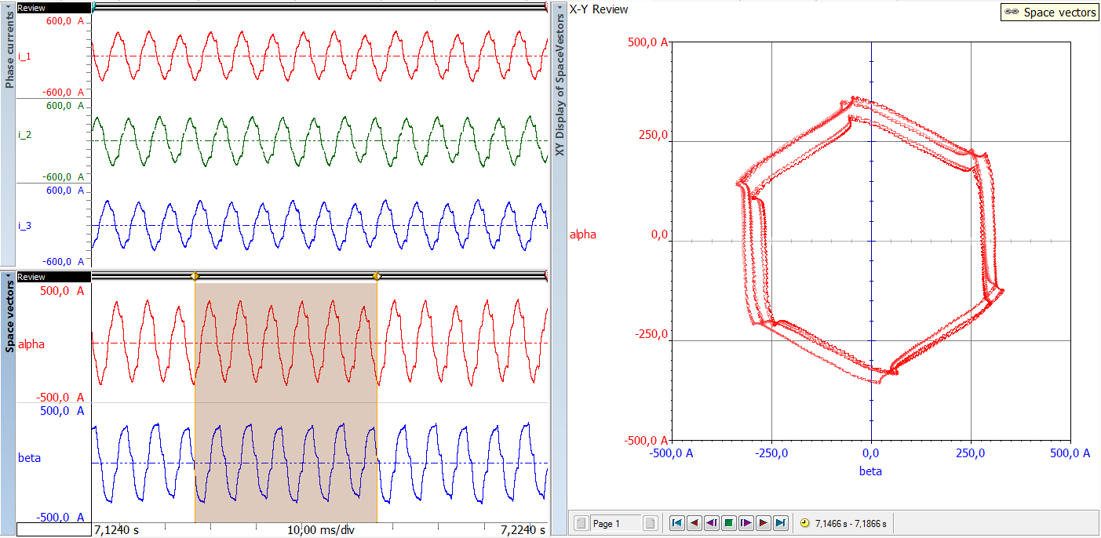
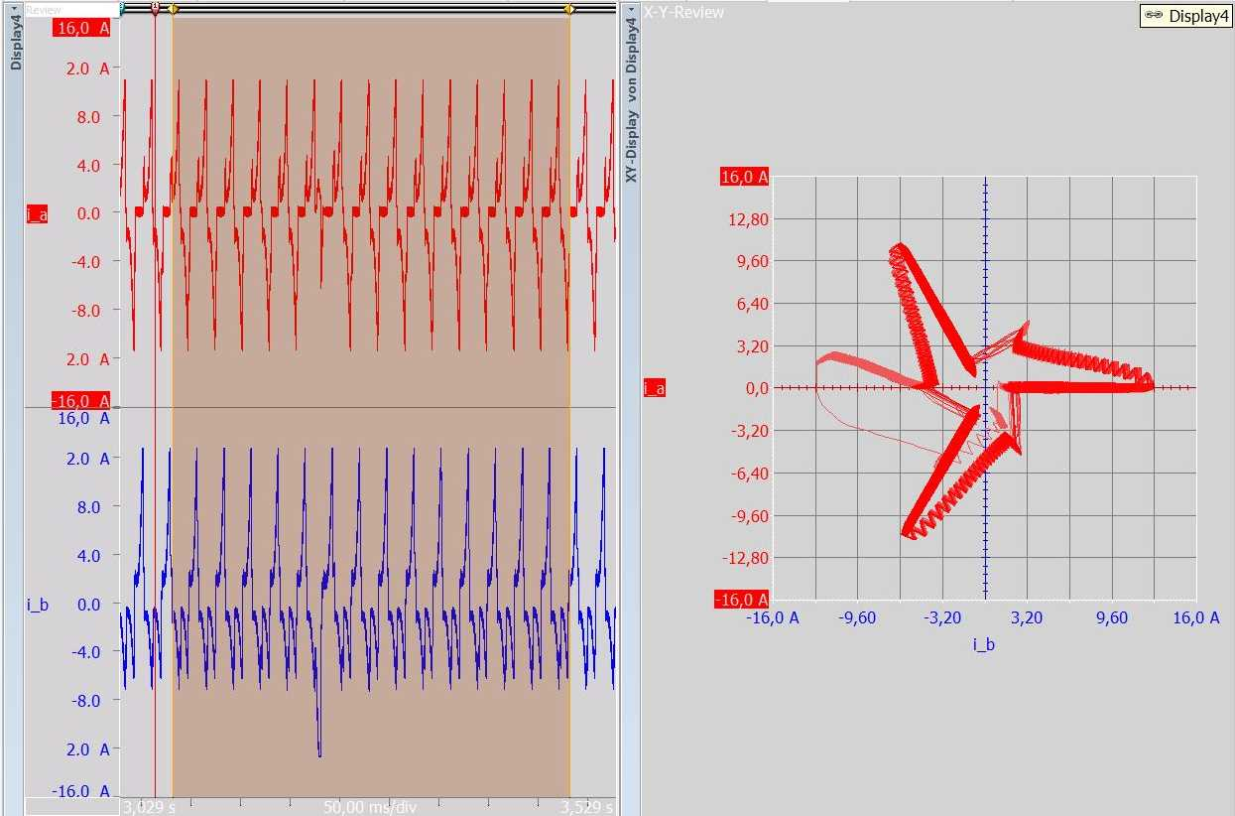
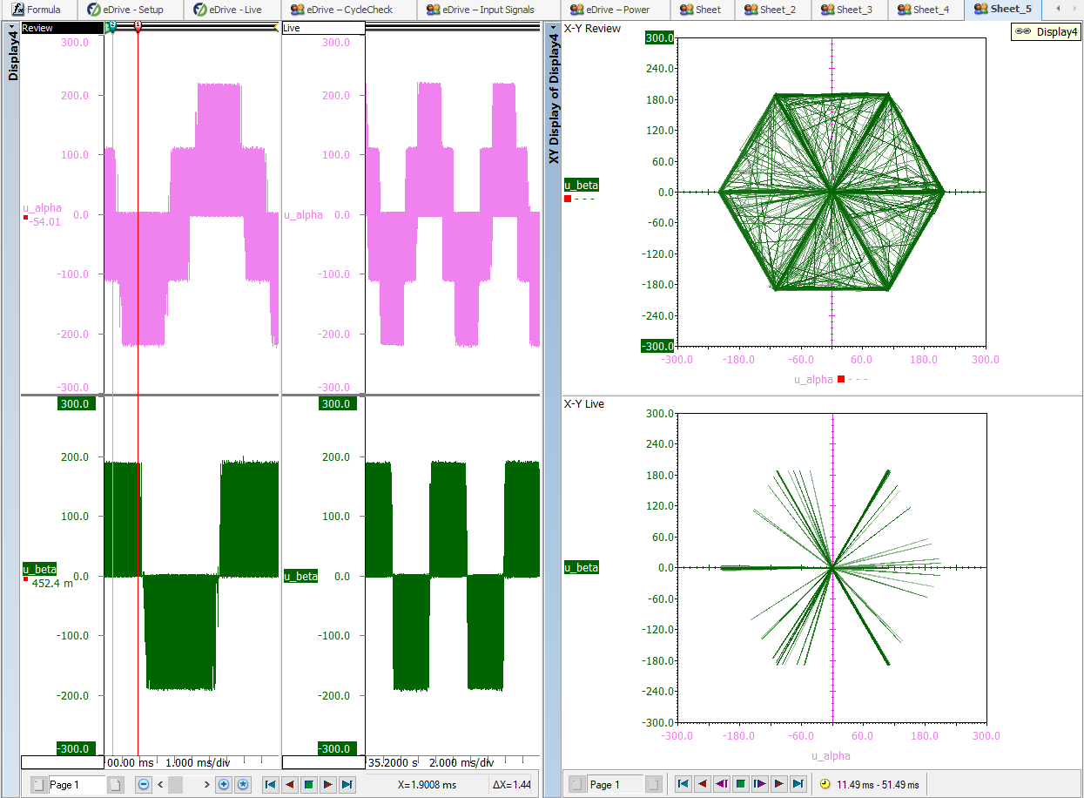
Space vector examples
HOME

Slide 25
Mitch Marks / Klaus Lang Business Development Manager – Electric Power Testing mitchell.marks@hbkworld.com klaus.lang@hbkworld.com
File: HBM Electric Power Testing - Advanced analysis examples 2020 03

